Slide 1
Social media DRIVEN MEME STOCKS STOCK PICKS
Trading via the sentiment of retail traders
Willson Pang DSI37
* Disclaimer: Not financial advice

Slide 2
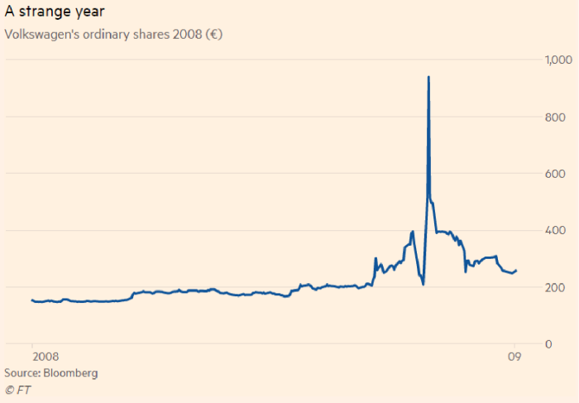
What is Short squeeze?
Figure 1: To the moon
Source:
https://www.google.com/url?sa=i&url=https%3A%2F%2Fwww.ft.com%2Fcontent%2F0a58b63a-4294-3e07-8390-c3aabef39a26&psig=AOvVaw2e6Sd-K48hL6EROLm8SFKM&ust=1691201787696000&source=images&cd=vfe&opi=89978449&ved=0CBEQjRxqFwoTCMiSkuD3wYADFQAAAAAdAAAAABAI

Slide 3
NUMBERS
$12
Billion
$6.8
Billion
$46
Million
LOSS
LOSS
GAINS
Losses that hedge funds incurred during 2021
Melvin Capital’s loss in a month during GME frenzy. They have now closed down
Amount of money Keith Gill made from his initial investment of $53,000
Source:
https://www.wsj.com/articles/melvin-plotkin-gamestop-losses-memestock-11643381321
https://www.ft.com/content/dcd86860-09ed-420e-a5cc-d6d281863c03
https://www.reuters.com/technology/year-gamestop-champion-roaring-kitty-is-quiet-yet-much-richer-2022-02-02/

Slide 4
52%
Amount of global assets that are under the management of retail investors and is expected to grow > 61% by 2030
Source:
https://www.weforum.org/agenda/2022/10/a-fresh-look-at-how-to-empower-retail-investors/

Slide 5
Factors that influence the inception of retail investors and meme stocks
01
02
03
04
$0 trading apps
& fractional shares
Pandemic downtime
Stock trading has never been more accessible than ever, individuals are able to buy stocks with as little as $1
Pandemic has locked people up at home with a lot of free time
STIMULUS MONEY
SOCIAL MEDIA FRENZY
Governments were handing out free money in an attempt to stimulate the economy
With the free money and time, people started to band together on social medias to discuss of means to invest and make more money
Source:
https://www.thestreet.com/dictionary/r/retail-investors

Slide 6
“Retail investor activity could continue to have reverberating effects on the market, and may further shift dynamics among institution investors. Taking steps to facilitate strategic transformation and shore up resiliency could be key for firms stay ahead of this next step in the evolution of retail investing.”
—Deloitte
Source:
https://www2.deloitte.com/us/en/pages/financial-services/articles/the-future-of-retail-brokerage.html

Slide 7
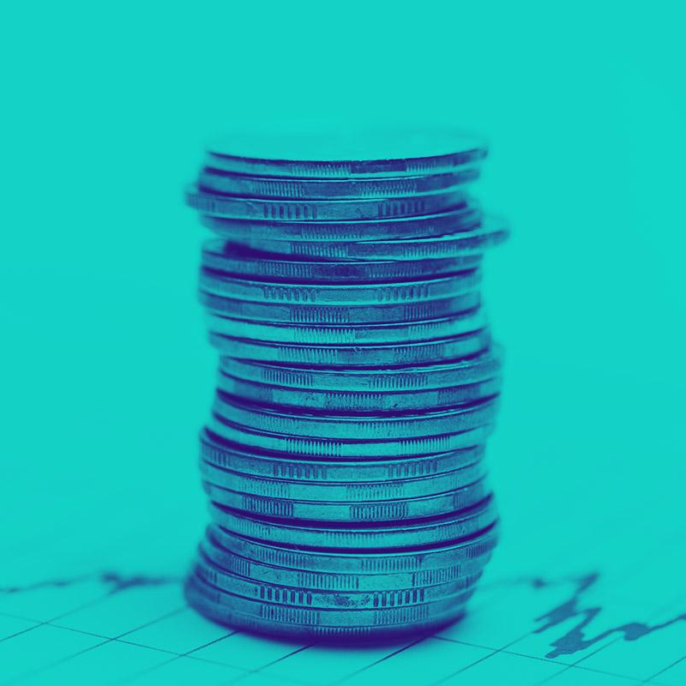
Problem Statement
To try to make money utilizing retail investors’ meme stocks frenzy while at the same time try to not lose money

Slide 8
WORKFLOW
Social Media
EDA
FORECAST Modelling
Reccomendation
Scraping posts from r/wallstreetbets & r/investing subreddit
Perform EDA to find out the most discussed stocks in each subreddit
Build a forecasting model to predict the stock price of the most discussed stocks
Build and deploy a visualization tool

Slide 9
01
Scraping & EDA
Finding out the stocks that is being talked about most

Slide 10



SCRAPING From reddit
r/wallstreetbets
r/investing
The main subreddit that generated the meme stocks frenzy, adopts high risk, degenerative strategy
The subreddit that is more mature, and grounded. Adopts a lower risk, conservative strategy

Slide 11
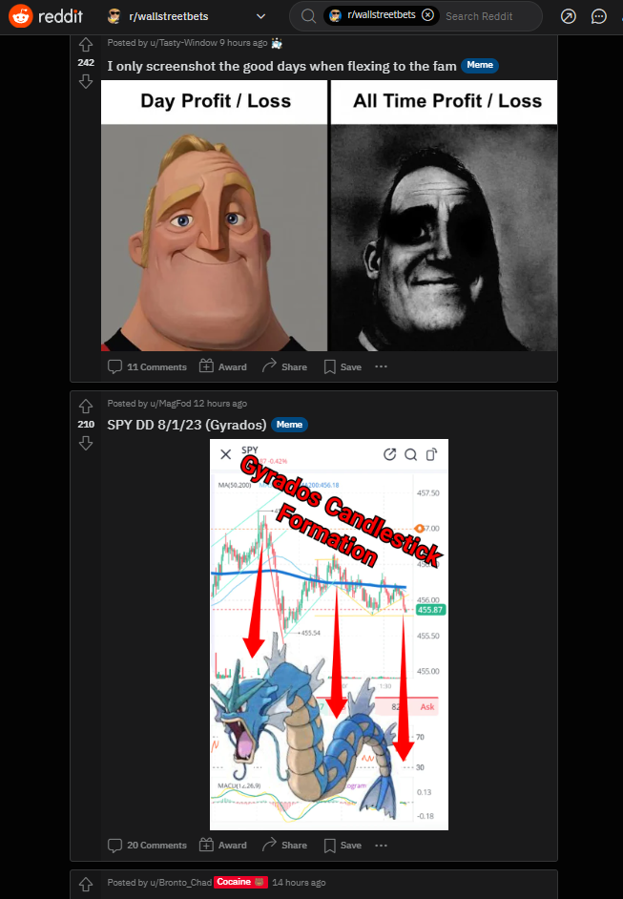
SCRAPING From reddit
r/wallstreetbets contains more images as the community tend to post more memes than actually writing down their due diligence

Slide 12
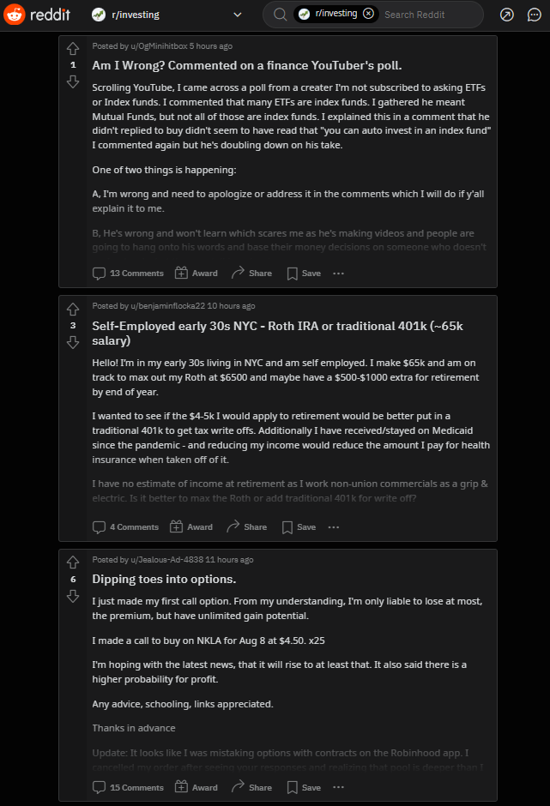
SCRAPING From reddit
r/investing contains more written posts as the community are generally a bit more financially literate and do actually write down their due diligence and discuss their view

Slide 13




EDA & extraction
SCRAPE
CLEANING
Feature ENGR
EXTRACTION
Scrape the respective subreddits using reddit api PRAW
Extracting the most discussed ticker symbols in each subreddit
Cleaning the scraped data, check for null entries, duplicates, datatypes, etc
Merging feature, splitting words, defining stop words, filter for potential ticker symbols

Slide 14
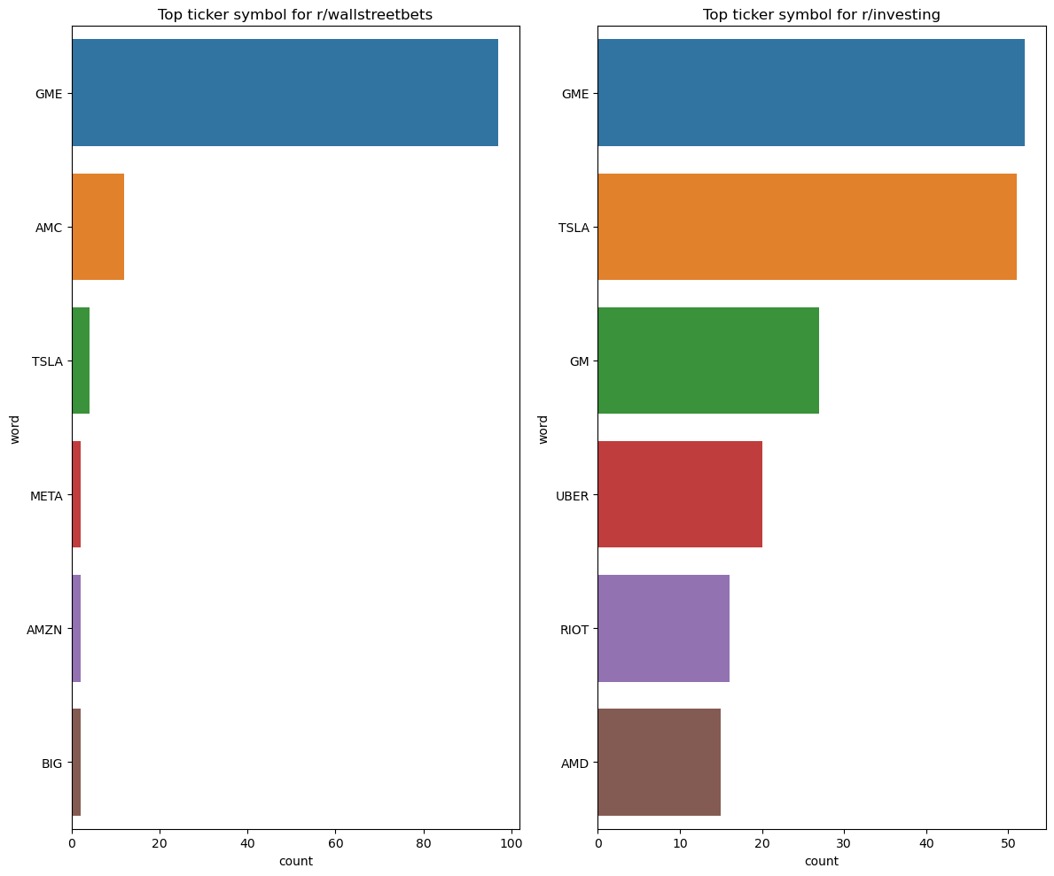
EXTRACTED TICKET SYMBOLS From reddit
r/wallstreetbets
Most discussed ticker symbols:
GME
AMC
TSLA
META

Slide 15
EXTRACTED TICKET SYMBOLS From reddit
r/investing
Most discussed ticker symbols:
GM
UBER
RIOT
AMD

Slide 16
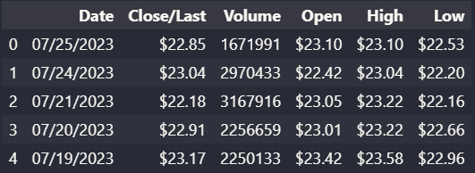
CALculating for VWAP
Sample of historical data

Slide 17
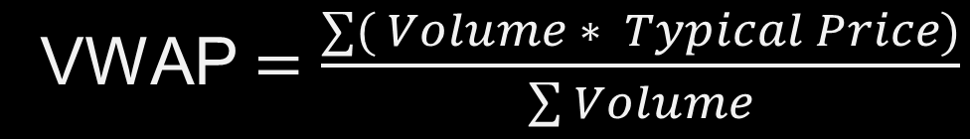
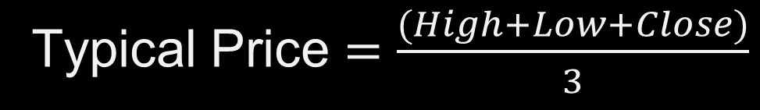
CALculating for VWAP
VWAP: Volume Weighted Average Price
Ratio of the value of a security traded to the total volume of transactions during a trading session.
VWAP $=\frac{∑( Volume ∗ Typical Price)}{\sum{Volume}}$
Typical Price $=\frac{(High+Low+Close)}{3}$

Slide 18

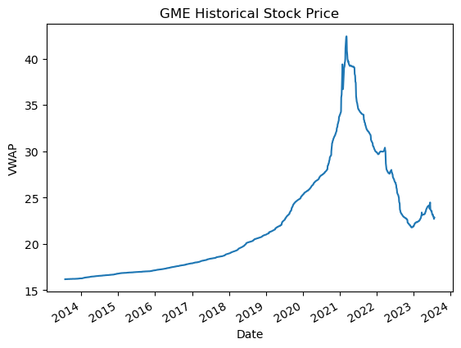
Gamestop historical stock price
VWAP ($) :
Volume Weighted Average Price
- Ratio of the value of a security traded to the total volume of transactions during a trading session.

Slide 19

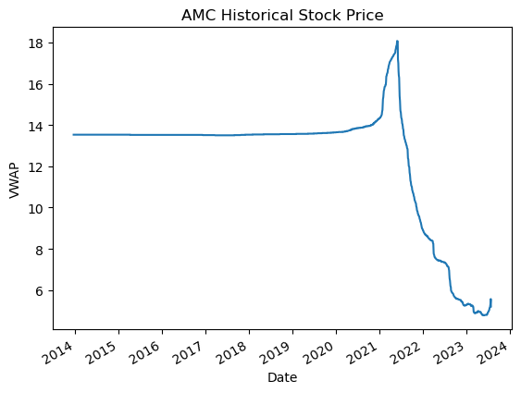
AMC historical stock price
VWAP ($) :
Volume Weighted Average Price
- Ratio of the value of a security traded to the total volume of transactions during a trading session.

Slide 20

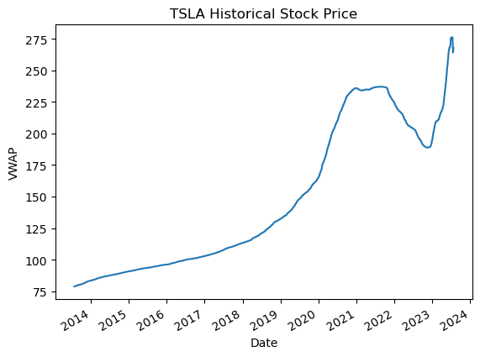
TESLA historical stock price
VWAP ($) :
Volume Weighted Average Price
- Ratio of the value of a security traded to the total volume of transactions during a trading session.

Slide 21

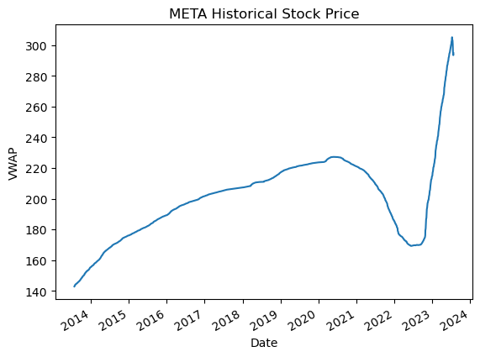
META historical stock price
VWAP ($) :
Volume Weighted Average Price
- Ratio of the value of a security traded to the total volume of transactions during a trading session.

Slide 22

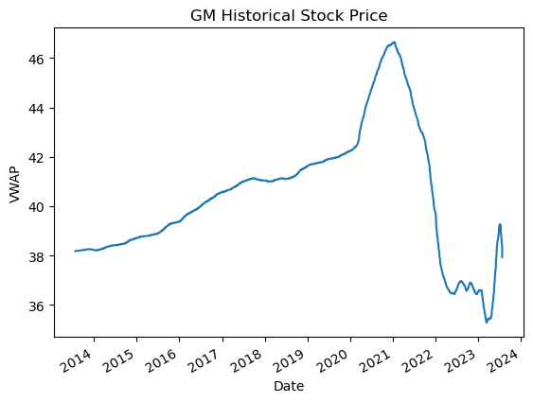
GM historical stock price
VWAP ($) :
Volume Weighted Average Price
- Ratio of the value of a security traded to the total volume of transactions during a trading session.

Slide 23

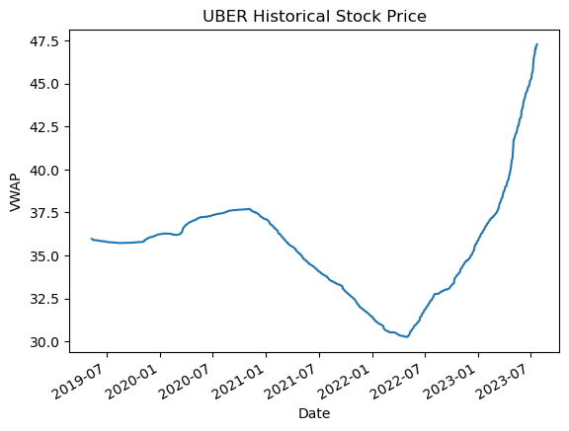
UBER historical stock price
VWAP ($) :
Volume Weighted Average Price
- Ratio of the value of a security traded to the total volume of transactions during a trading session.

Slide 24

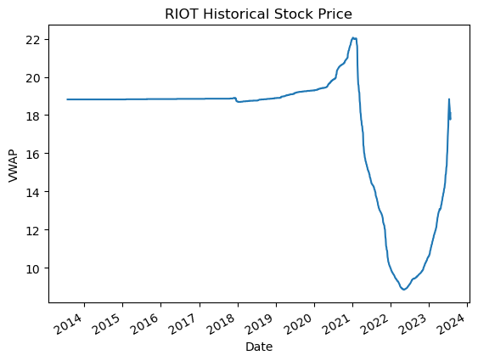
RIOT Platforms historical stock price
VWAP ($) :
Volume Weighted Average Price
- Ratio of the value of a security traded to the total volume of transactions during a trading session.

Slide 25

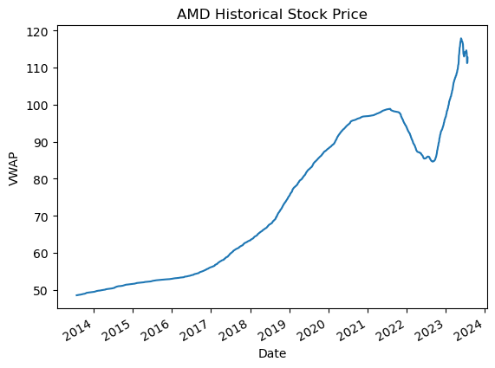
AMD historical stock price
VWAP ($) :
Volume Weighted Average Price
- Ratio of the value of a security traded to the total volume of transactions during a trading session.

Slide 26
02
FORECAST MODELLING
Building up the model to forecast the future stock prices

Slide 27
Regression Models
 | R2 | MAPE
Orthongonal Matching Pursuit (OMP) | -0.72 | 8.46%
Linear Regression | -0.72 | 8.4%
Ridge Regression | -0.72 | 8.47%
Random Forest Regressor | -1.94 | 8.97%

Slide 28
Other Models
 | R2 | MAPE
Huber Regressor with Condition, Deseasonalize & Detrending | -0.55 | 0.36%
Auto ARIMA | -0.7 | 0.39%
Theta Forecaster | -2.47 | 0.64%
Naïve Forecaster | -3.0 | 0.67%

Slide 29

Fbprophet (Final)
 | R2 | MAPE
GME | 0.98 | 2.01%
AMC | 0.98 | 2.36%
TSLA | 0.97 | 2.91%
META | 0.72 | 3.86%

Slide 30

Fbprophet (Final)
 | R2 | MAPE
GM | 0.92 | 1.05%
UBER | 0.99 | 0.18%
RIOT | 0.90 | 4.4%
AMD | 0.96 | 2.28%

Slide 31
03
RecommendATION
So what to make of it?

Slide 32
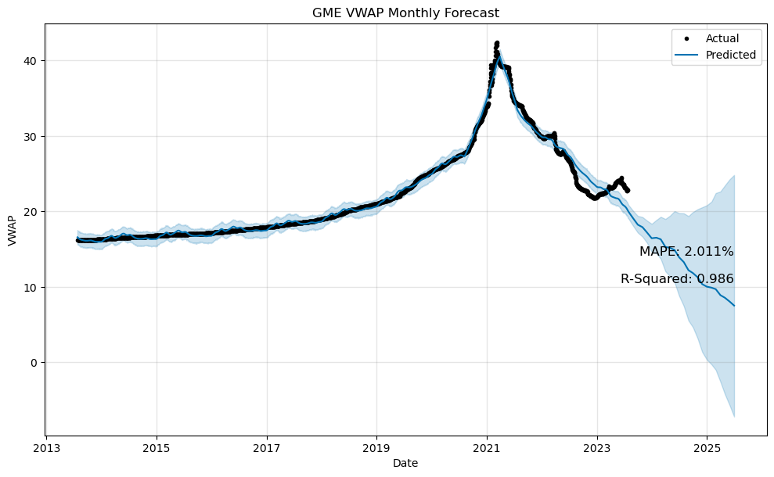
Gamestop stock price FORECAST
Forecast Period : 2 years
Recommendation:
SELL

Slide 33
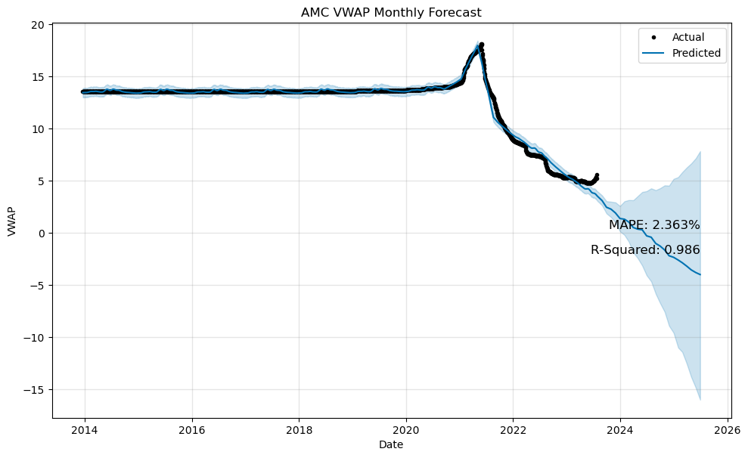
AMC stock price FORECAST
Forecast Period : 2 years
Recommendation:
SELL

Slide 34
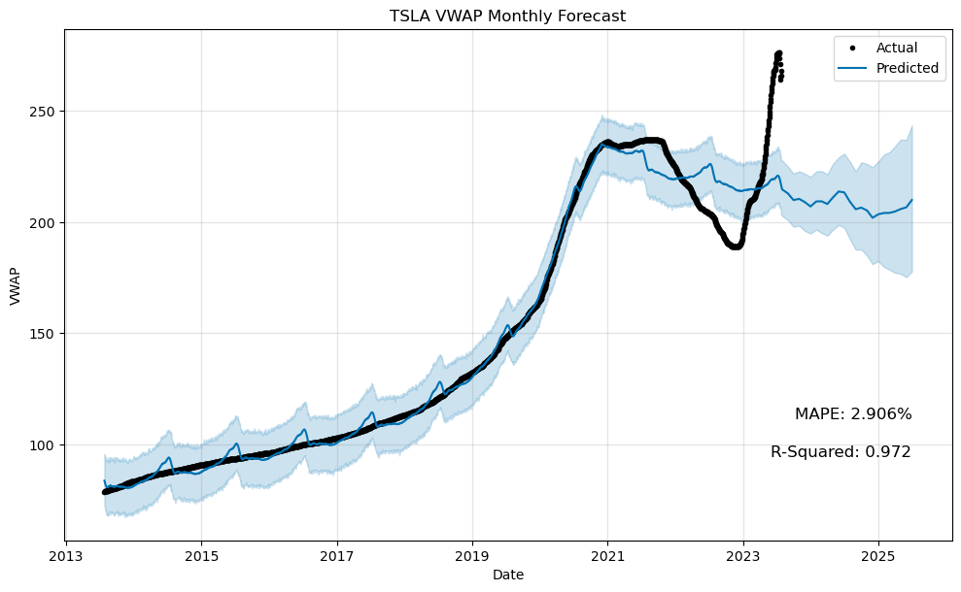
TESLA stock price FORECAST
Forecast Period : 2 years
Recommendation:
Depends on your personal risk tolerance

Slide 35
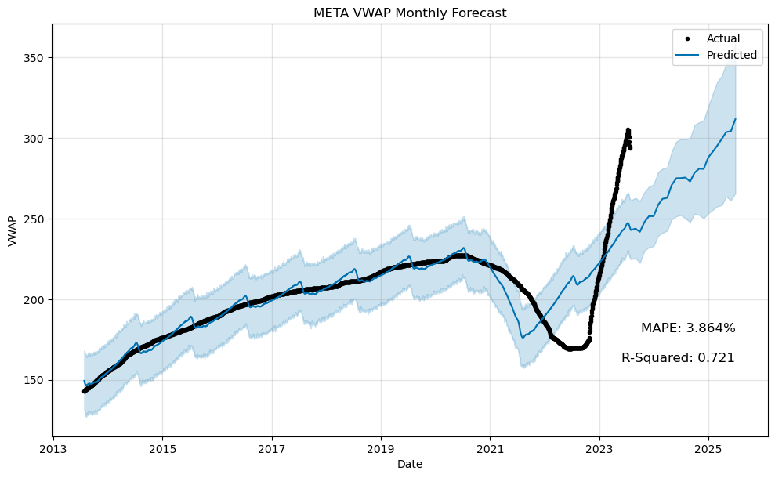
META stock price FORECAST
Forecast Period : 2 years
Recommendation:
BUY

Slide 36
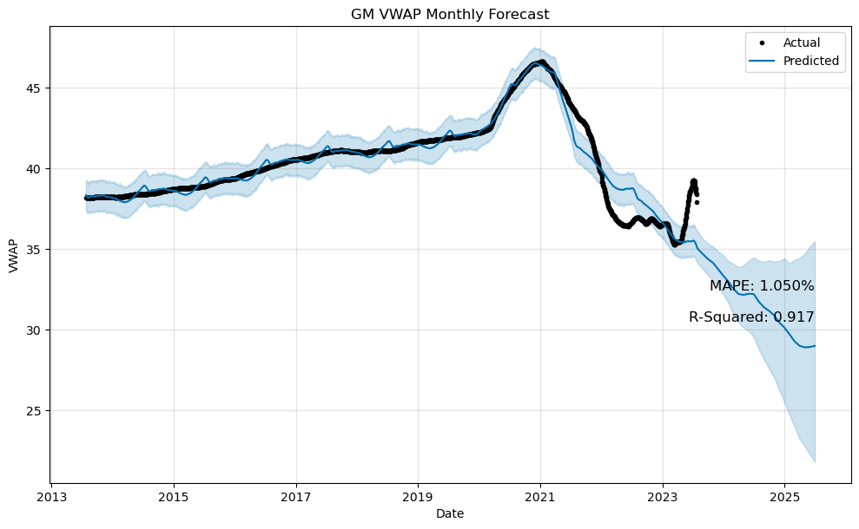
GM stock price FORECAST
Forecast Period : 2 years
Recommendation:
SELL

Slide 37
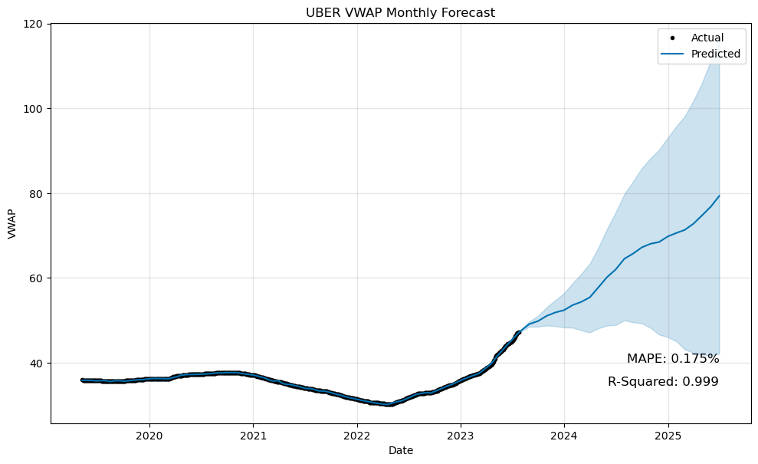
UBER stock price FORECAST
Forecast Period : 2 years
Recommendation:
BUY

Slide 38
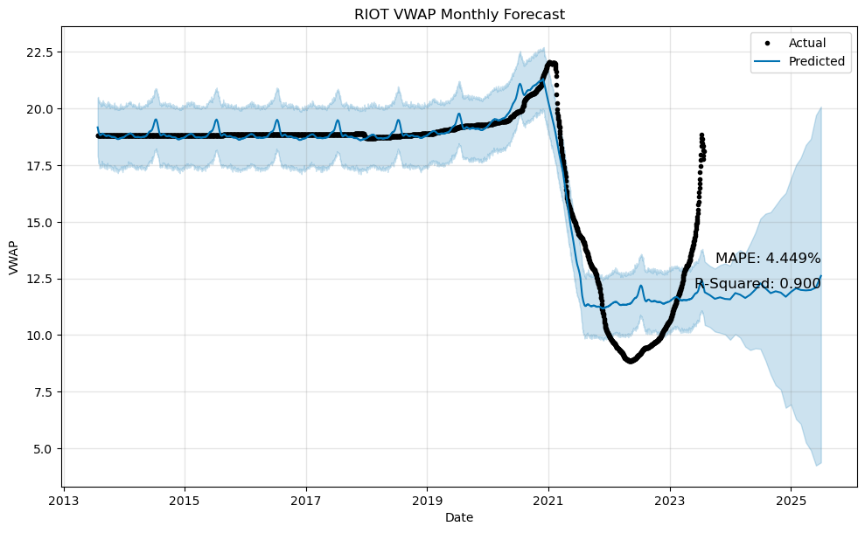
RIOT Platforms stock price FORECAST
Forecast Period : 2 years
Recommendation:
Depends
on your personal risk tolerance

Slide 39
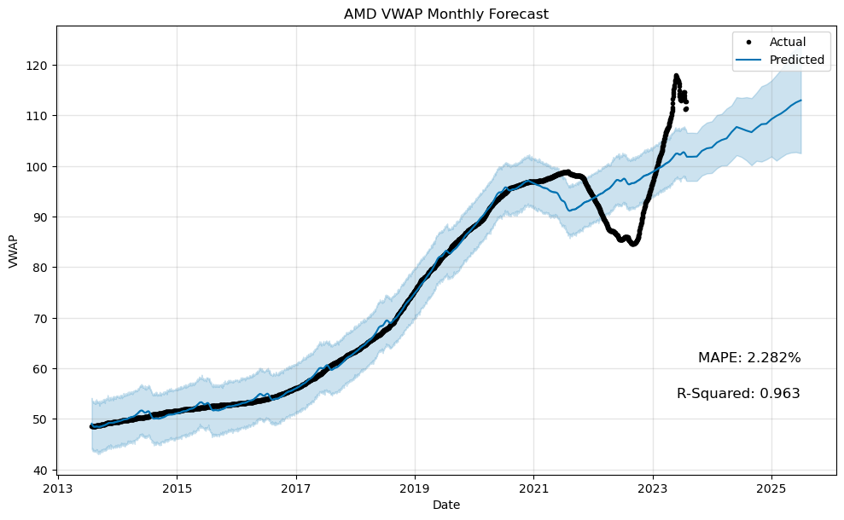
AMD stock price FORECAST
Forecast Period : 2 years
Recommendation:
BUY

Slide 40
Disclaimers
This is NOT financial advise.
Please always consult a professional investment advisor before making any investment decision.
Correlation does not imply causation.
“Nobody knows if a stock is gonna go up, down, sideways, or in circles.”
Mark Hanna, Wolf of Wall Street (2013)
“All models are wrong, but some are useful.”
George Box

Slide 41
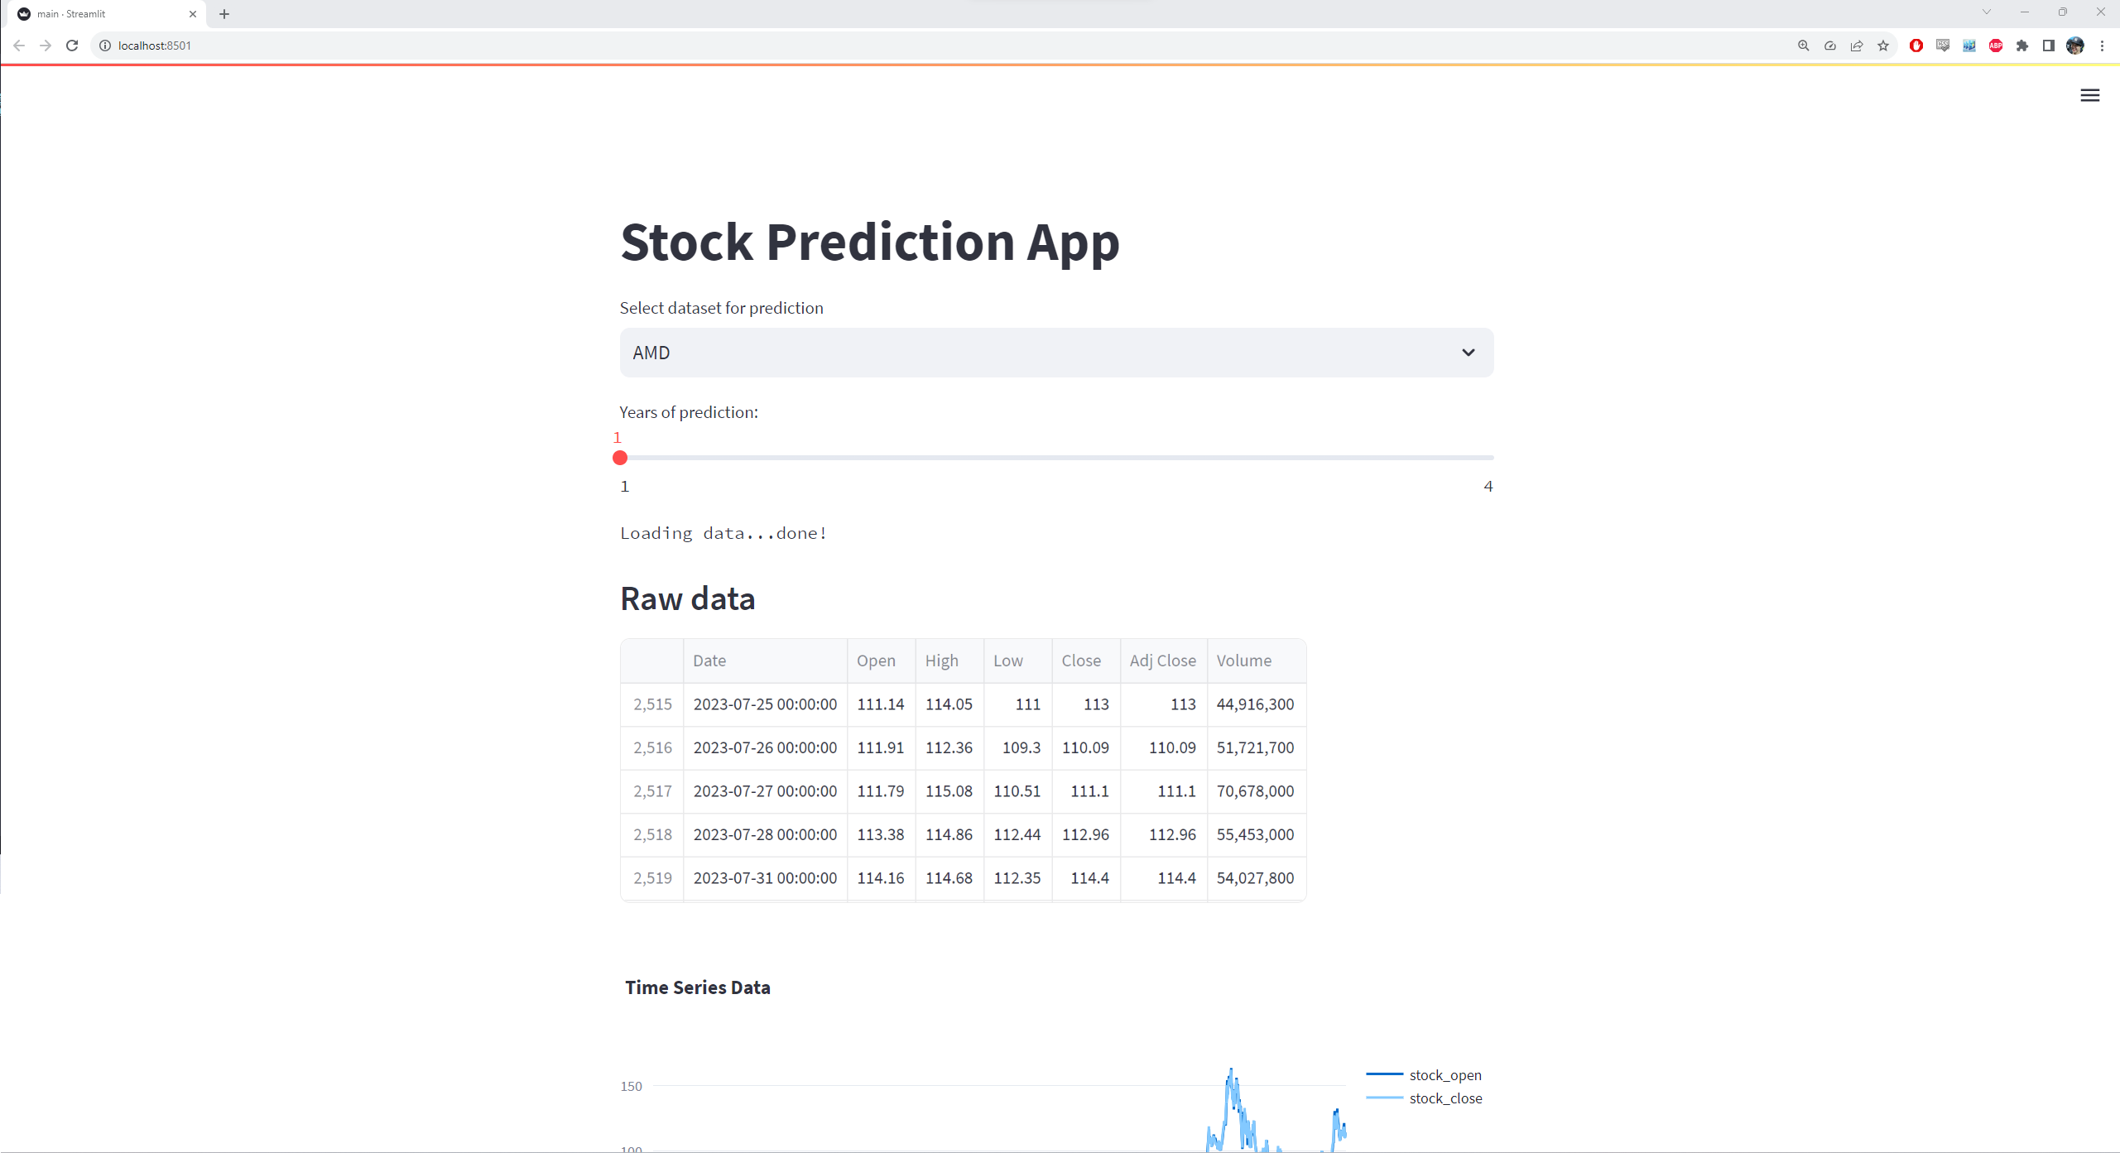
04
DEMONstration
Demonstration of the streamlit visualization dashboard

Slide 42



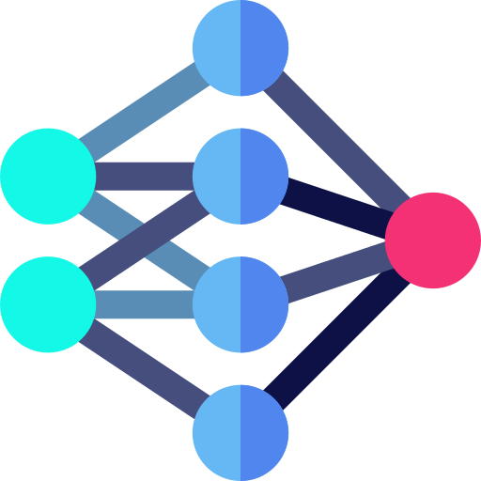
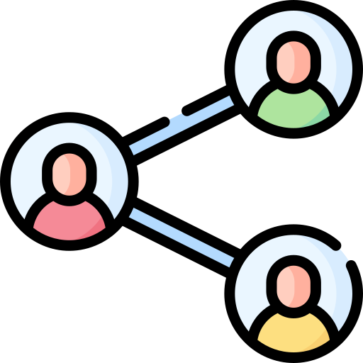

Future works
NLP
DYNAMIC
EXpansion
To implement more advanced NLP techniques into the process of filtering for ticker symbols from social media
To implement dynamic data to get updated predictions everytime the app is used
Expand our selection of stocks to generate forecast for whicever stock the user is interested in
Neural networks
Social medias
Sentiment
To test and implement other neural network forecasting model in an attempt to develop a model that can better deal with non-stationary data
To expand our data collection to other forms of social media other than reddit to better grasp retail investors’ hype
To build and implement a robust sentiment analysis model to also incorporate sentiment retail investors’ to each ticker symbol

Slide 43
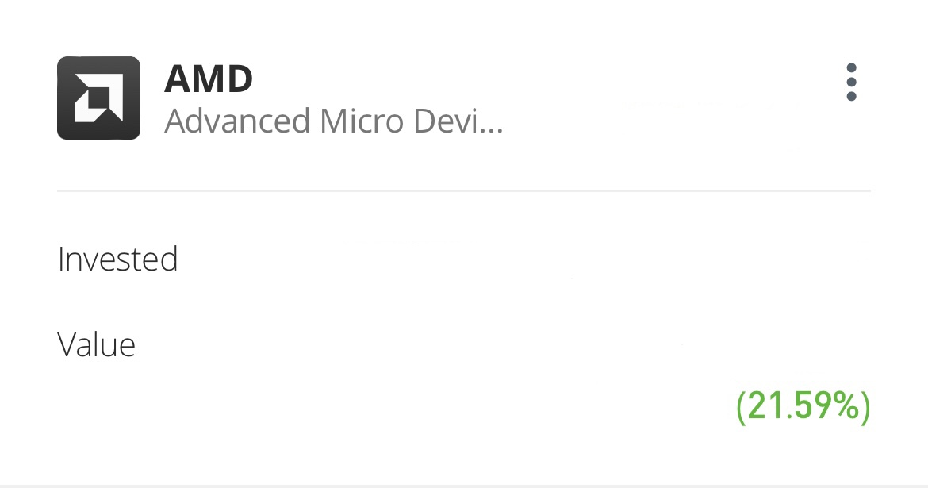
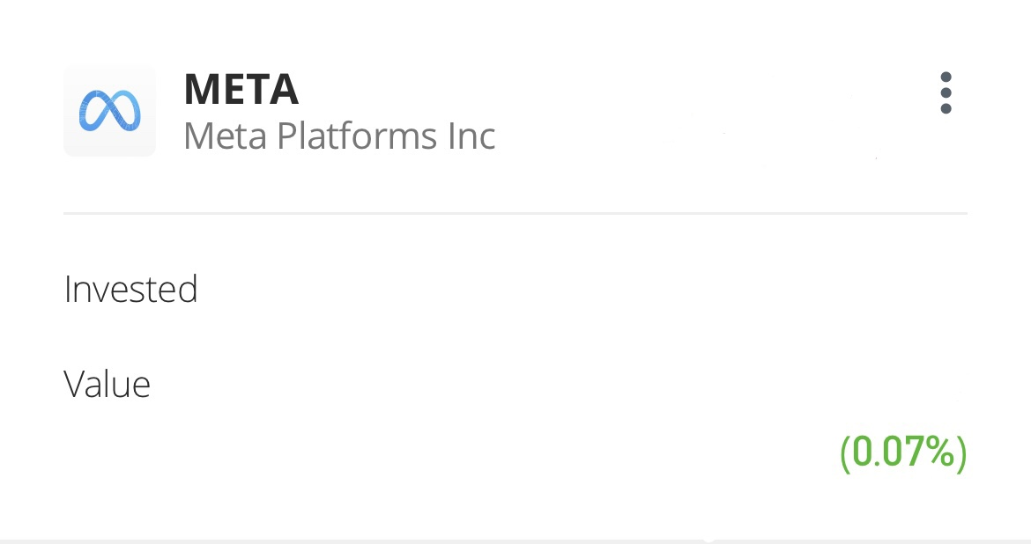
Thanks!
Do you have any questions?
Wanna fund me? Kindly approached me to discuss for future collaboration opportunities.

